Slide 1
IPL - 2017
A Data Analysis on the Indian Premier League

Slide 2
Table of contents
What are we trying to solve ?
Data
Analysis of Data
Insights and Conclusion

Slide 3
What do we need to solve?
We need to get the analysis for the following:-
The most successful team in the tournament.
The most successful players in the tournament, with the most runs and wickets.
Teams and Players companies are most likely to endorse.

Slide 4
The DATA
The IPL data consists of factors such as the name of the teams, toss decisions, winners, man of the match, total runs, total wickets.

Slide 5
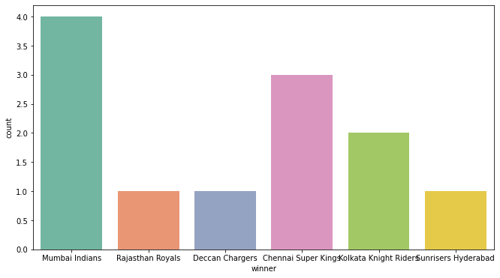
Number of IPL tournaments each teams have won over the years.
Mumbai Indians have 4 wins, followed by CSK with 3 wins and KKR with 2 wins.
The top 3 teams can be taken into account for company endorsements.

Slide 6
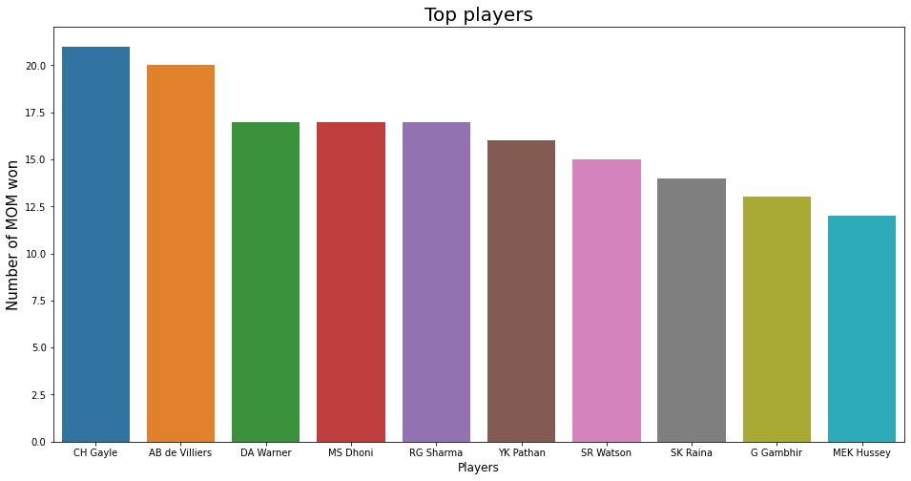
Top players.
Man of the matches won by each player is taken into account for determining the top players.
Gayle, ABD and Warner are the top 3 players with the most man of the matches.

Slide 7
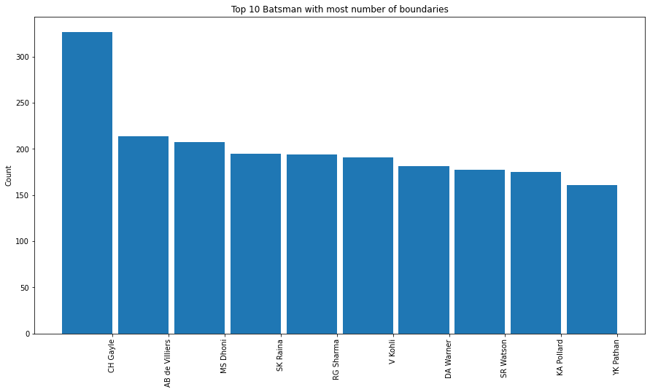
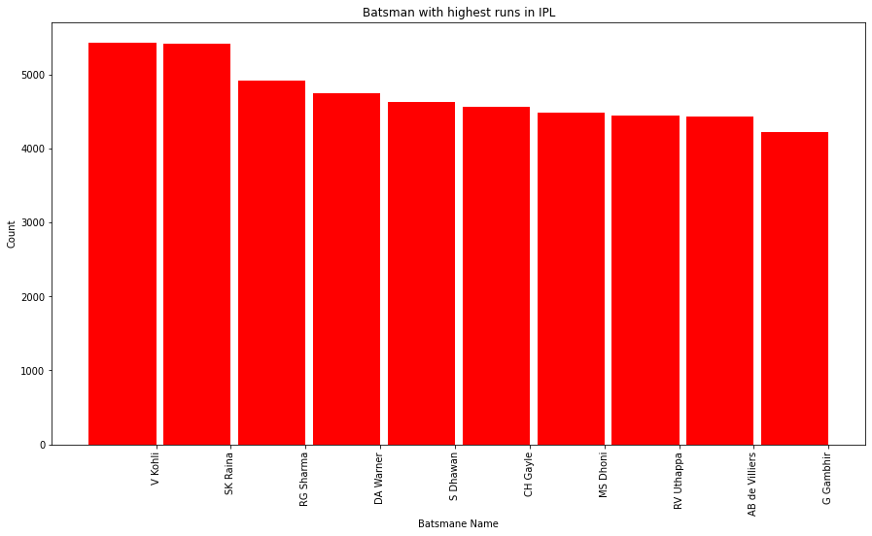
Top batsmen with most boundaries
Top batsmen with highest runs

Slide 8
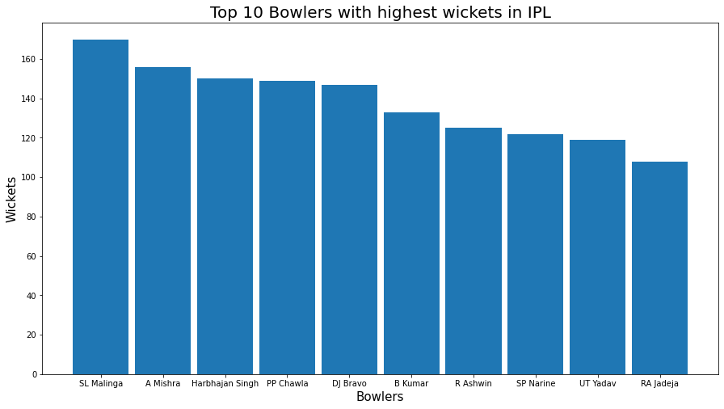

Slide 9
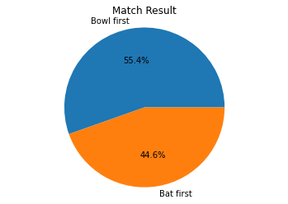
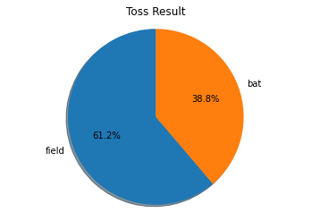
Toss and key decisions that affected the game
55.4 % teams that bowled first won the match.
44.6% teams won that batted first.
61.2% teams that won the toss and chose to field won the game.
38.8% teams that won the toss and chose to bat won the game.

Slide 10
INSIGHTS
Companies should focus on endorsing Mumbai Indians, Chennai Super Kings and KKR. The top three teams to win the IPL.
Batsmen to endorse are Gayle, ABD, MS Dhoni, V Kohli and Raina.
Bowlers to endorse Malinga, Mishra and Harbhajan Singh.

Slide 11
CODE

Slide 12
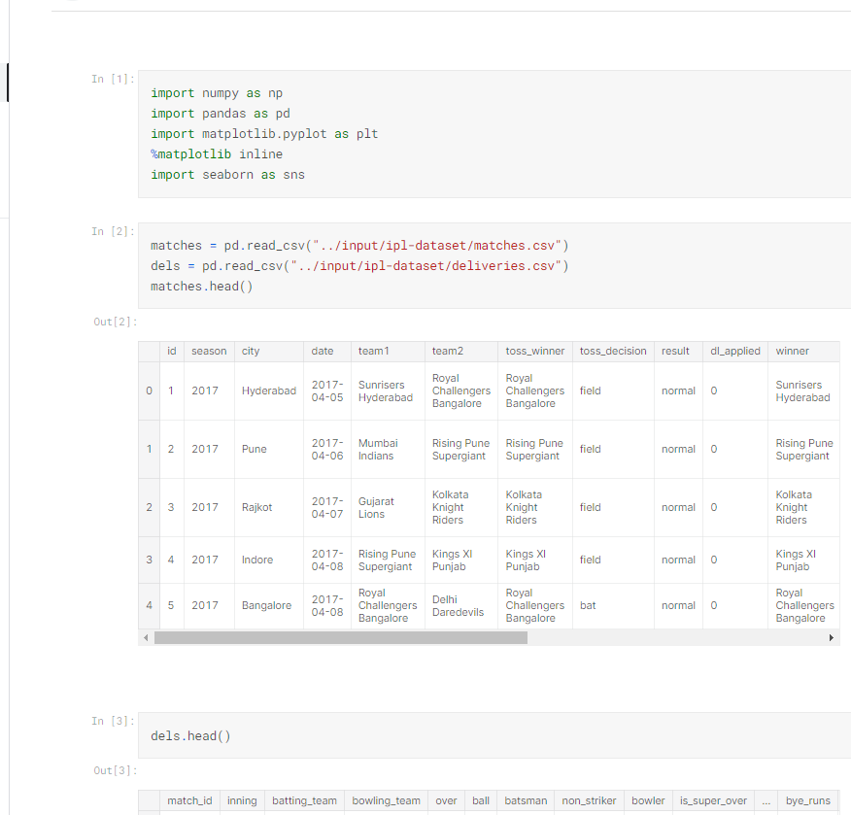
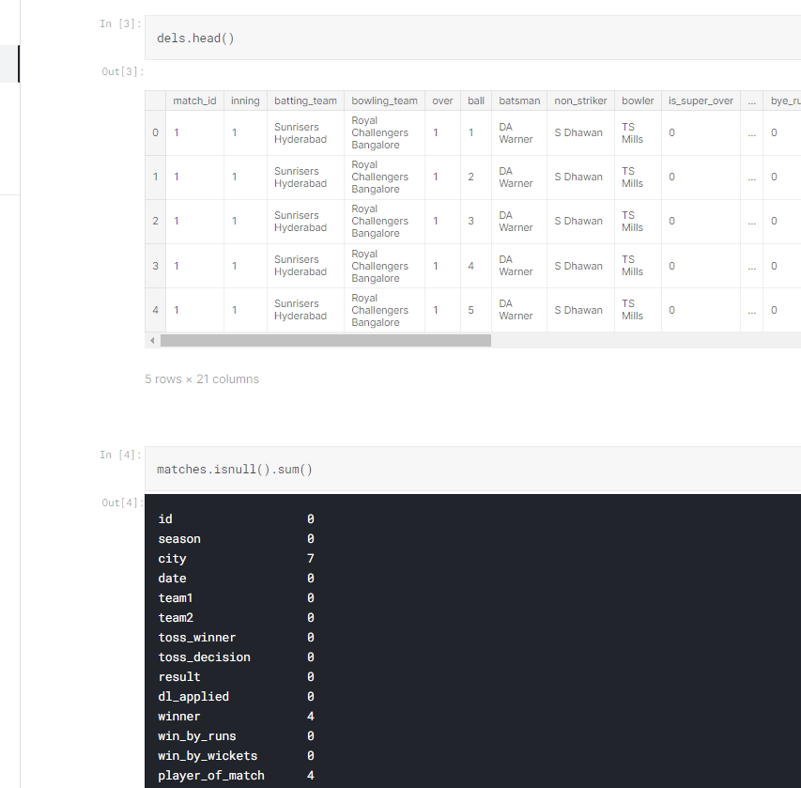

Slide 13
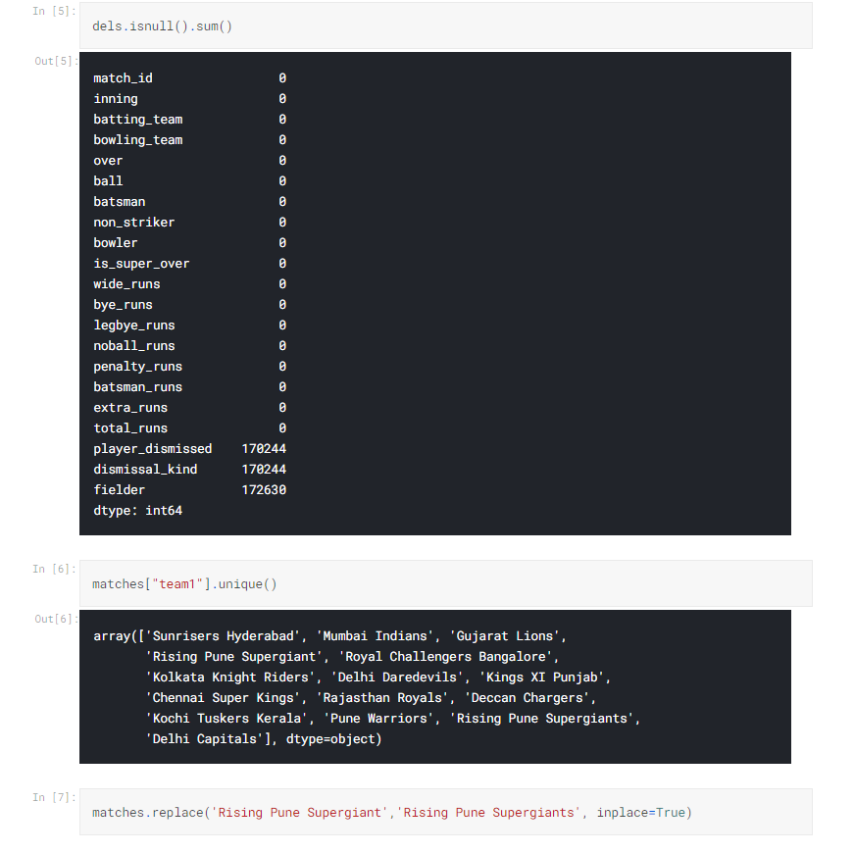
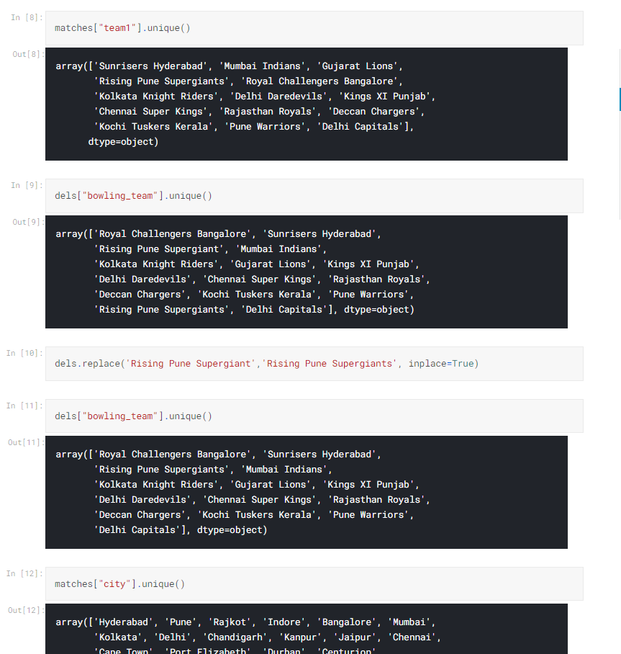

Slide 14
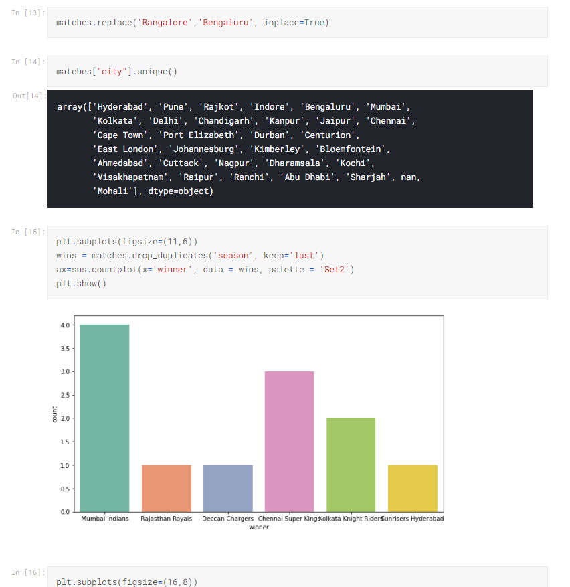
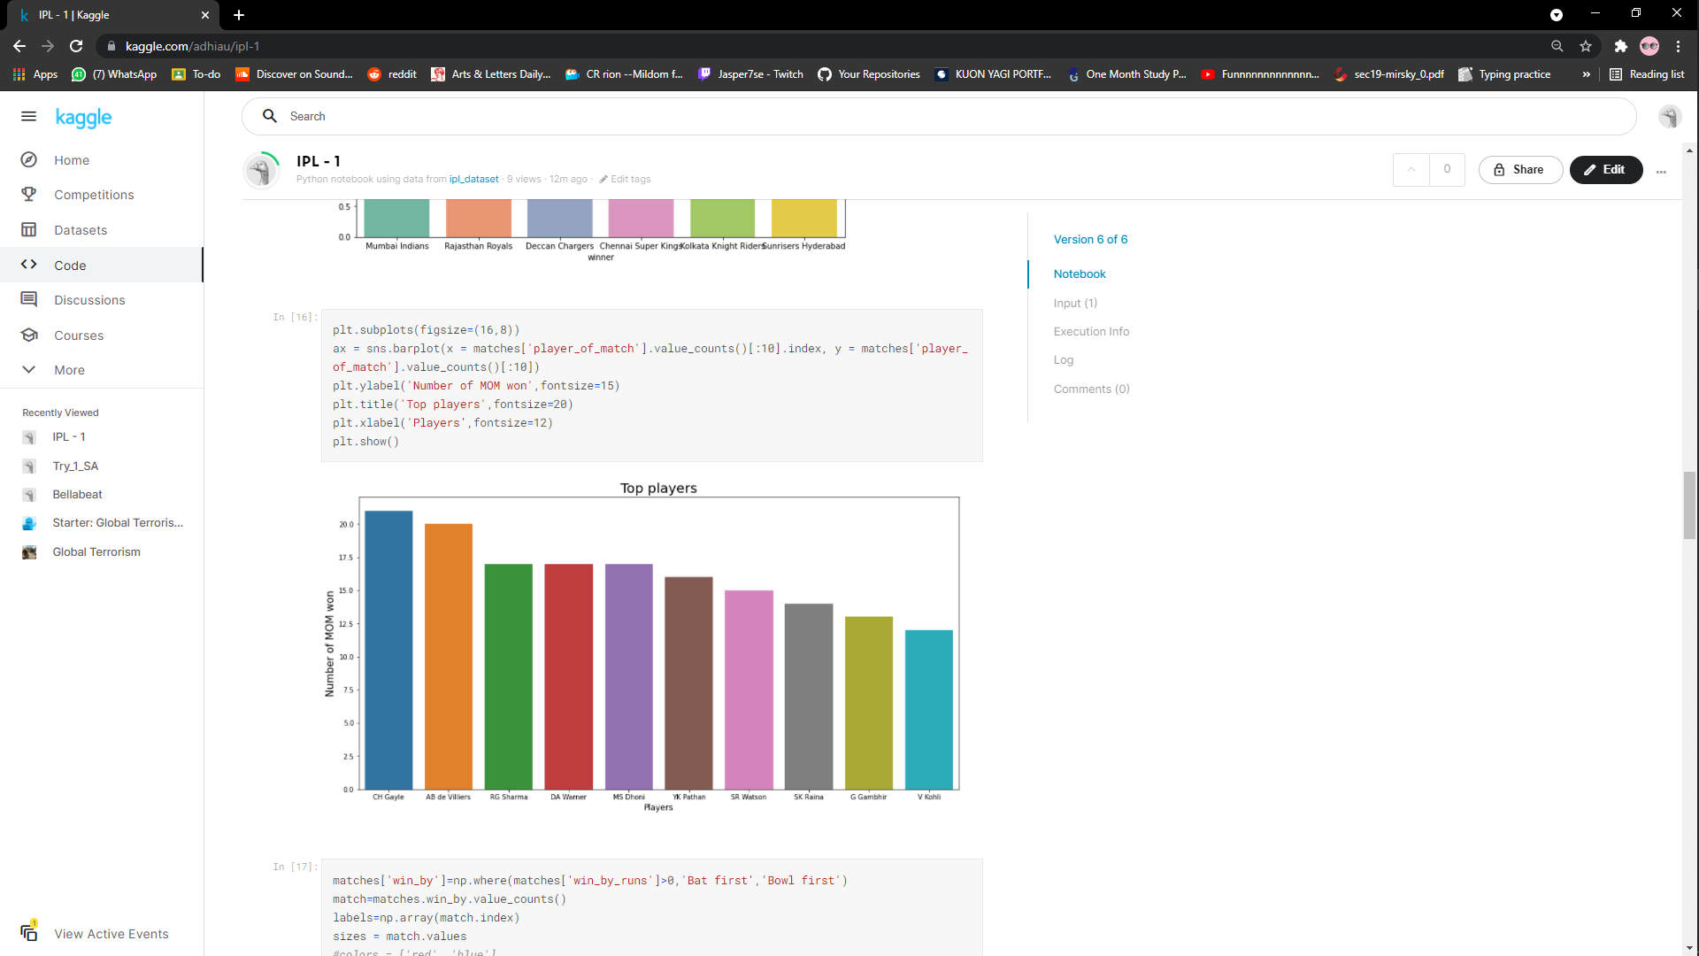

Slide 15
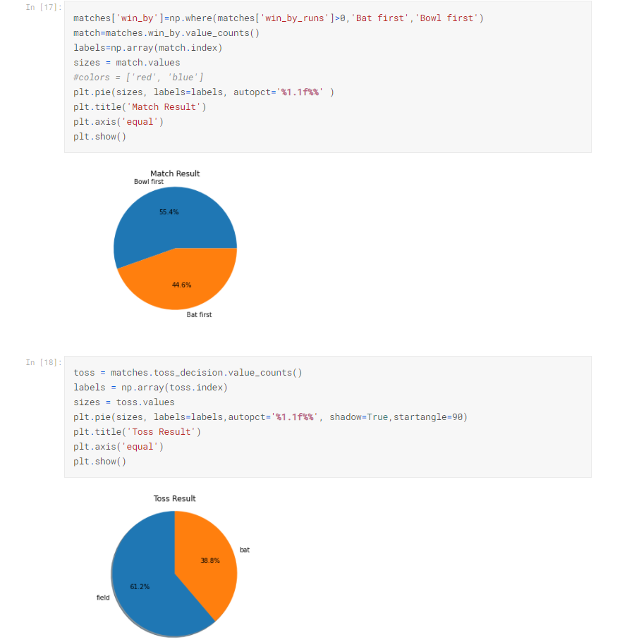
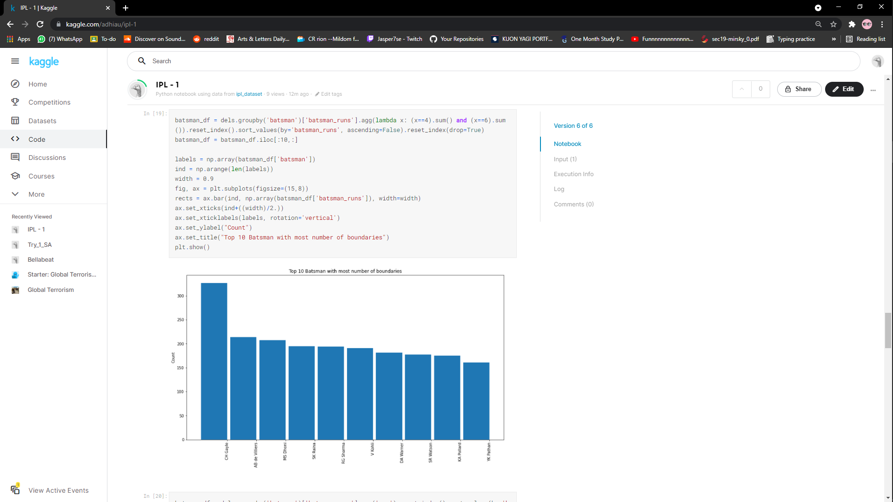

Slide 16
